Slide 1

S.P.A
By Shor Lior, Pollak Idan and Adrian Haim
Final Project
Software Engineering
Holon Institute of Technology, 2020

Slide 2
The project
S.P.A is a virtual electronic store developed by 3 students from the faculty of computer science, Holon Institute of Technology
We created a friendly desktop application with easy to use interface for both the users and the management of an electronic store
We developed the application using Java language with Swing framework
The application was developed in accordance to our architecture documents

Slide 3
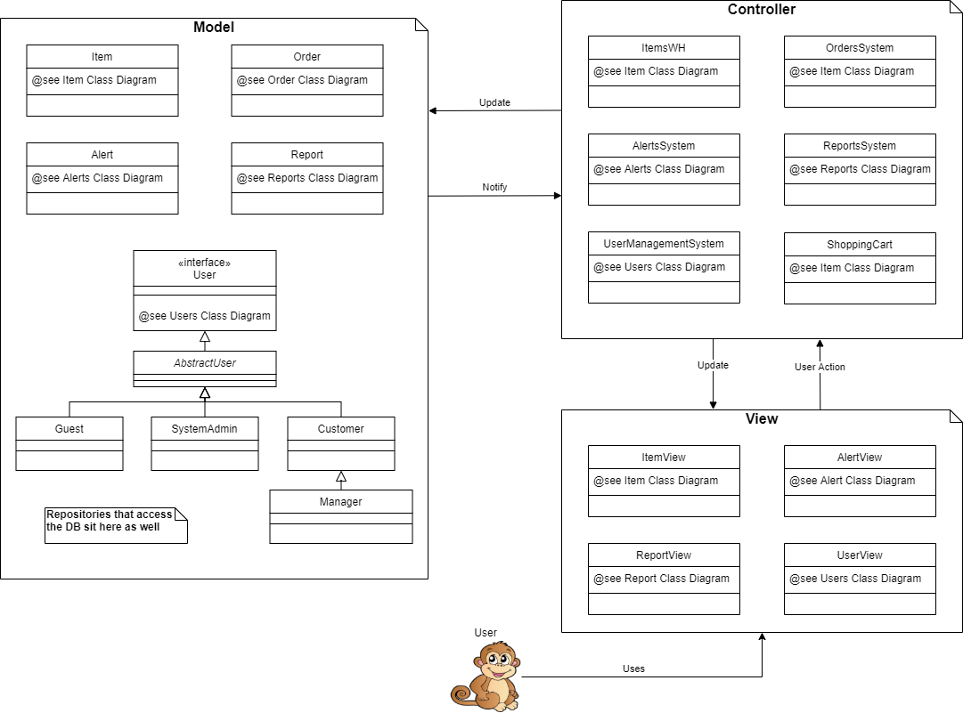
The architecture
The architecture we chose to work with in this project is MVC
We made a separation of the model from view and controller in order to make it easier to change the model layer with a DB access in the future. Hence the business logic is implemented at the controller layer.

Slide 4
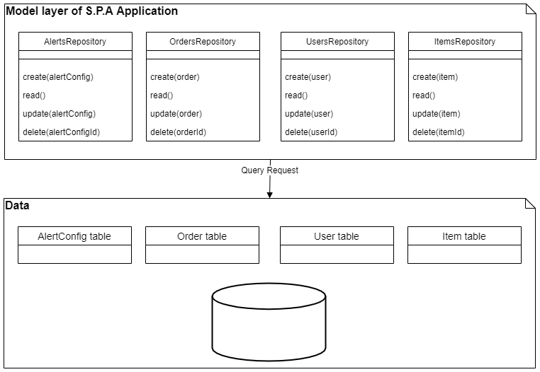
The architecture CONT.
The data access is implemented using the Repository pattern, such that there is a single data source for reading and persisting data.

Slide 5
DESIGN PATTERNS
Observer
Used by various systems in order to notify listeners (at the view level) about updates of the model.
Command
Actions in the application are separated into classes with single responsibility according to the Command pattern.
Factory Method
Concrete actions are created by using the Factory Method pattern
Singleton
Maintain unique instance of sub-systems within one singleton class

Slide 6
LINKS
Project source
https://github.com/haimadrian/SE-Java-Project
Wiki
https://github.com/haimadrian/SE-Java-Project/wiki
Continues Integration
https://github.com/haimadrian/SE-Java-Project/actions?query=workflow%3A%22Build+SPAApplication%22
Video
https://www.youtube.com/watch?v=MyhIwLgkjFY

